Slide 1
BRICK BREAKER GAME
BY GAURI GARG
CSIT-5A
1900290110034

Slide 2
INTRODUCTION
Brick Breaker Game has a small ball that hits the bricks with the help of a little paddle the bottom. The player uses this paddle bounce the ball . The more you break the bricks, the more you score . If you miss the ball to bounce then game over . The player wins the game if he/she is able to clear all the balls in 3 lives.

Slide 3
Milestones of the project
1. Display bricks and disappear after hitting the ball.
2. Small paddle moving left or right.
3. The ball must bounce after hitting brick and paddle at the bottom.
4. Score display.

Slide 4
Technologies Used
1. HTML,
2. CSS &
3. JAVA SCRIPT

Slide 5
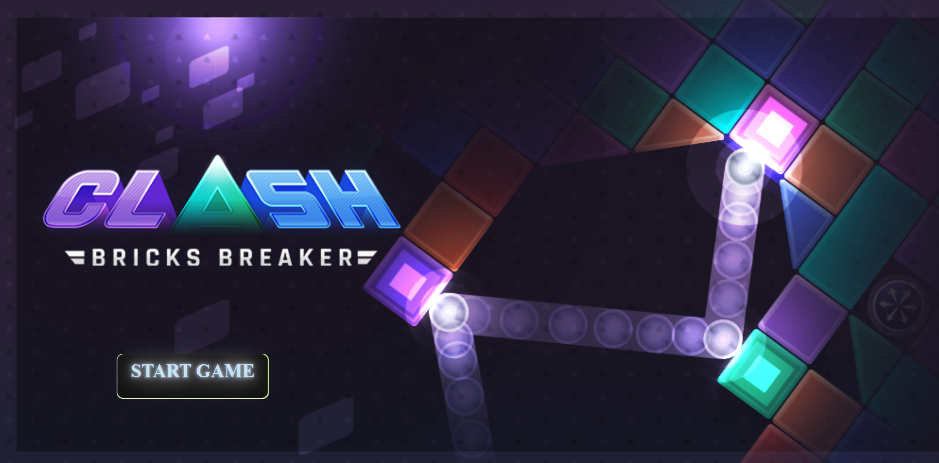
Screenshots of the Game

Slide 6
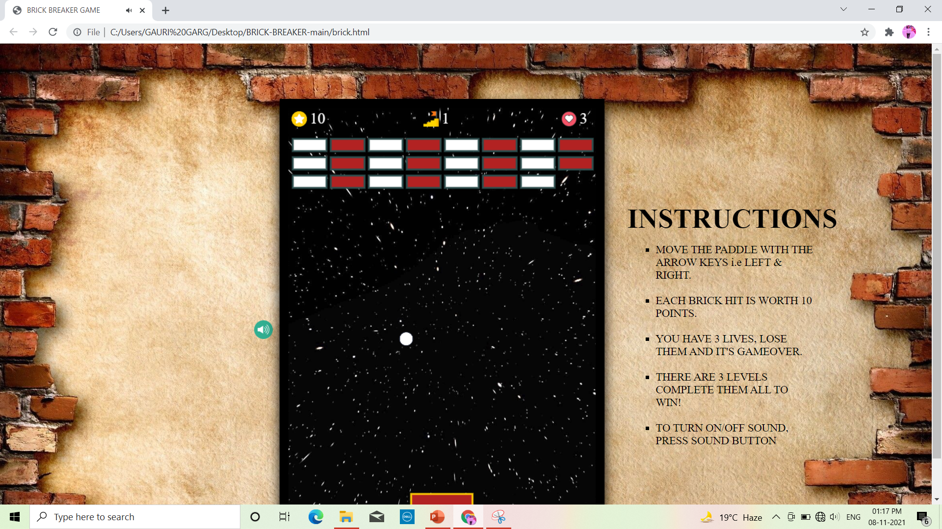
MAIN PAGE

Slide 7
THANK YOU

